Slide 1


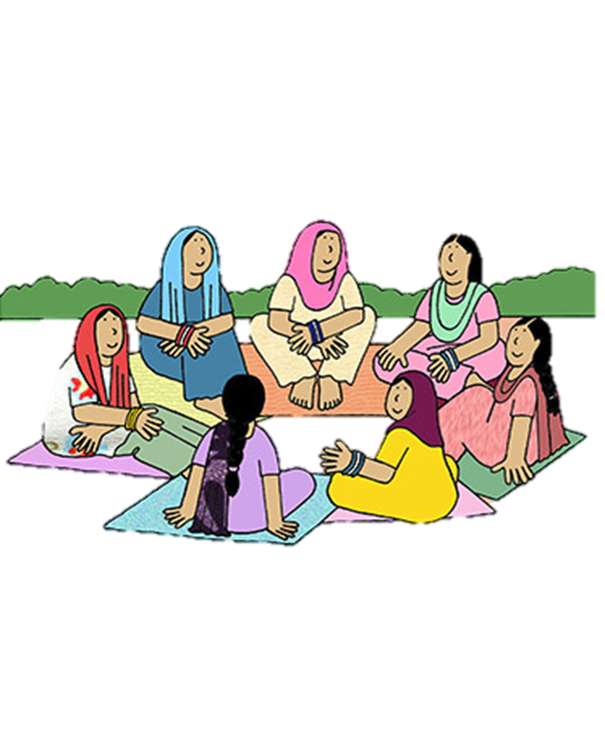


Ministry of Rural Development
DAY-NRLM
Session 1
Training registration
CRPs
0

Slide 2


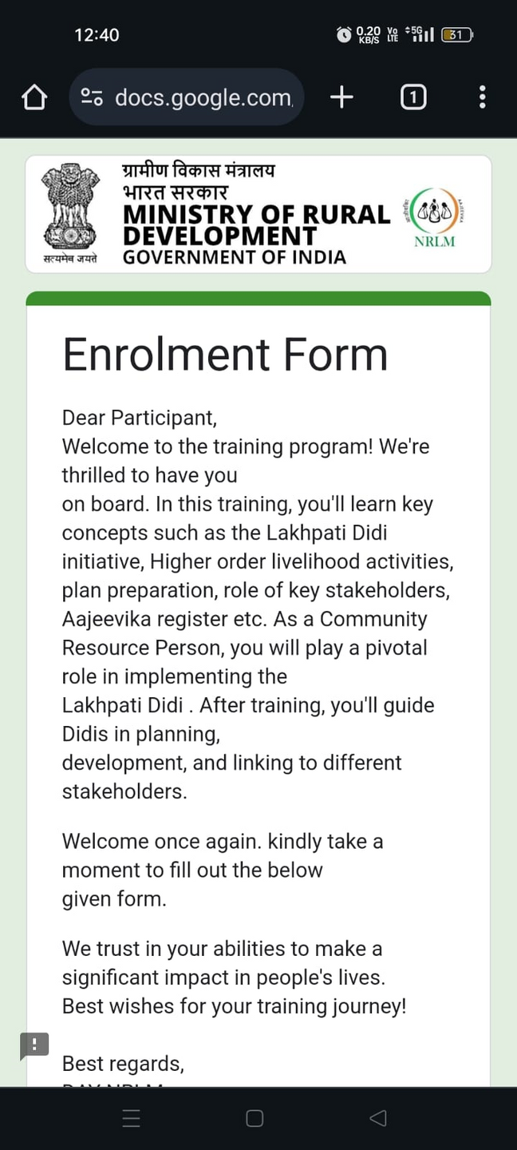


TRAINING ENROLLMENT
Fill the enrollment forms
It will help us in communicating with you
Form a whatsapp group of participants and share the link to fill registration form
Link
Alternative : Use the physical copy of registration form given to you

Slide 3
Steps for Online Registration
Step-1: Note down your SHG ID and Member ID from NRLM Database:
https://nrlm.gov.in/shgOuterReports.do?methodName=showShgreport
Click on the Link.
Select the State> District> Block> Gram Panchayat> Village> SHG Group Name.
Note down the
SHG ID: Example. BH1409677 for the SHG Named AASMI
Member ID: Example BH15913608 for the Member KHUDEJA
Notedown your Member Id and SHG Id following above steps

Slide 4
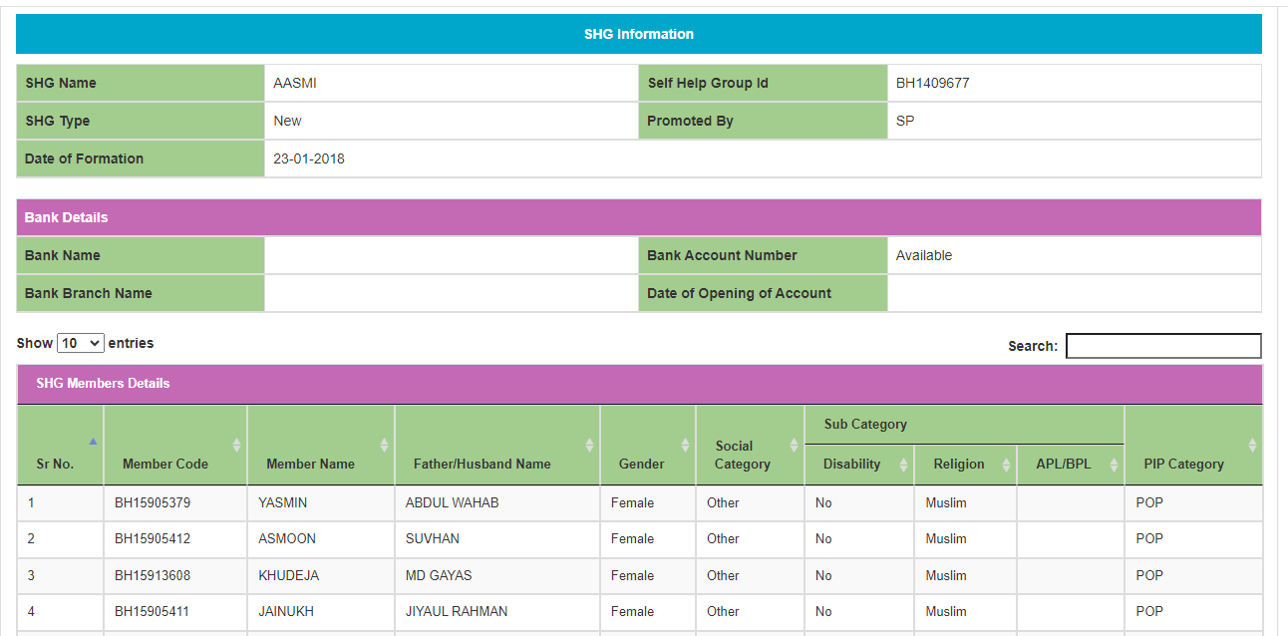

Slide 5
State Wise Links
Share Link mentioned against your State with the CRPs
Sl. | State Name | CRP Enrollment Google form link
1 | ANDAMAN AND NICOBAR | https://forms.gle/WF7dEr6M3FuLrzta7
2 | ANDHRA PRADESH | https://forms.gle/nzkdoMXiAZhGWyRV9
3 | ARUNACHAL PRADESH | https://forms.gle/nM9X2WGStTjw7RFN6
4 | ASSAM | https://forms.gle/1XY62WH7g2aJzzwJ6
5 | BIHAR | https://forms.gle/S7DQDqPL7MHmTKBs9
6 | CHHATTISGARH | https://forms.gle/DFNAxq4rV4BH8p8r5
7 | GOA | https://forms.gle/SwdRcBD9fTZDNE6s6
8 | GUJARAT | https://forms.gle/vC4ZCziynL5uoXah9
9 | HARYANA | https://forms.gle/qAJAS1tYsoh6Jkfk6
10 | HIMACHAL PRADESH | https://forms.gle/moH3XvYsdpbHqQ4M8
11 | JAMMU AND KASHMIR | https://forms.gle/hYkyNEtXPY2r5MTY6
12 | JHARKHAND | https://forms.gle/maTCP2h3zjy9tNoX8

Slide 6
State Wise Links
hare Link mentioned against your State with the CRPs
Sl. | State Name | CRP Enrollment Google form link
13 | KARNATAKA | https://forms.gle/NJQzsTyJPBk9bMZe8
14 | KERALA | https://forms.gle/GWxF7D1yoVePdXaGA
15 | LADAKH | https://forms.gle/LM3aDUCLp3XQjUq47
16 | LAKSHADWEEP | https://forms.gle/Y8LdctaU47Pn3aAd6
17 | MADHYA PRADESH | https://forms.gle/VsdqMJ1zyDcDGmNr6
18 | MAHARASHTRA | https://forms.gle/auXzaLkXTiSgkEJT6
19 | MANIPUR | https://forms.gle/UsXFEJNbjQ3Aikfn7
20 | MEGHALAYA | https://forms.gle/wvr1RKJtMaCF81Zi6
21 | MIZORAM | https://forms.gle/uMf4R2aajdbTpSEA6
22 | NAGALAND | https://forms.gle/8iXL64dxj5ZMSazE6
23 | ODISHA | https://forms.gle/1yg7ZFB91qRkG4u68
24 | PUDUCHERRY | https://forms.gle/x6LusAyuXpWkiJbk6

Slide 7
State Wise Links
hare Link mentioned against your State with the CRPs
Sl. | State Name | CRP Enrollment Google form link
25 | PUNJAB | https://forms.gle/vqaW1gDG8uDfTcj3A
26 | RAJASTHAN | https://forms.gle/DqwLwK3UnU3znfeN6
27 | SIKKIM | https://forms.gle/1eCUQX2ytoGj3LZF7
28 | TAMIL NADU | https://forms.gle/4oqR772xRqDMBxXPA
29 | TELANGANA | https://forms.gle/CBggd1UeLmku6LG2A
30 | THE DADRA AND NAGAR HAVELI AND DAMAN AND DIU | https://forms.gle/xVEU6aaANe7PjR7u6
31 | TRIPURA | https://forms.gle/sqw1qFVYPV2kW9ZXA
32 | UTTARAKHAND | https://forms.gle/jU8azVyKFDkCdwqF6
33 | UTTAR PRADESH | https://forms.gle/QjDcsF6RAfuwo2Xw8
34 | WEST BENGAL | https://forms.gle/LKzcPuXrk28AyZrr7
25 | PUNJAB | https://forms.gle/vqaW1gDG8uDfTcj3A
26 | RAJASTHAN | https://forms.gle/DqwLwK3UnU3znfeN6

Slide 8
Guide participants in filling up the following informations:
Training Start date and End Date
Name of the Trainers
Name of state, district,Block,Gram Panchayat, Village
Member ID and Group ID
Type of CRP Cadre
Mobile No and
Email id(optional)

Slide 9

Any questions?

